Slide 1


D365 CE Solution Modelling Workshop
Marketing | Sept 2026

Slide 2

Contents
Workshop | Annexure ID | BPM | Duration (minutes)
WS-CE-01 | 70 | External Analytics Data Ingestion & Unification | 120
WS-CE-02 | 61 | Marketing Research Insights Planning | 15
 | 54 | Global Marketing Content Activation | 20
 | 38 | Brand Reputation Campaign Management | 20
 | 58 | Marketing Asset Governance & Campaign Readiness | 35
 | 60 | Marketing Strategy & Activation Planning | 10

Slide 3

External Analytics Data Ingestion & Unification
01

Slide 4
Pre-read: External Analytics Data Ingestion & Unification
Read before the workshop
Microsoft Learn – Dynamics 365 Customer Insights
https://learn.microsoft.com/en-us/training/modules/get-started-customer-data-platform/ | https://learn.microsoft.com/en-us/training/modules/configure-third-party-connections/
Please review:
Data ingestion from external sources
Data unification and profile resolution
Unified customer and analytics views
Analytics, insights, and reporting capabilities
Bring to the workshop
Please have the following ready and circulated to the team:
List of external analytics platforms and data sources
Sample reports, dashboards, and KPI definitions
Current data consolidation process and ownership
Known data quality or reporting challenges
Come ready to decide
Decisions we intend to close in this session:
Which external analytics sources are in scope
Priority KPIs and reporting requirements
Definition of the unified analytics view
Reporting and dashboard consumption approach

Slide 5
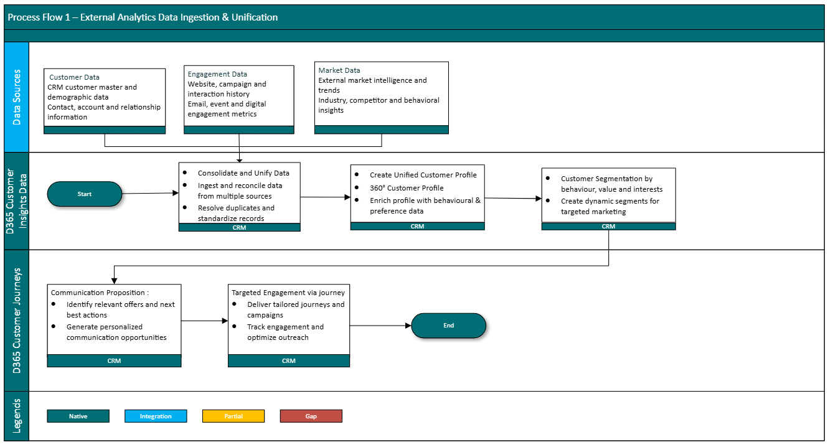
Process Flow 1 – External Analytics Data Ingestion & Unification
Standard D365 Customer Insights out-of-the-box, no customisation assumed

Slide 6
Process details: External Analytics Data Ingestion & Unification
External Analytics Data Sources
Definition: Analytics data originates from multiple external platforms and business systems and is brought together for reporting and insights.
Data may be sourced from marketing, web, service, survey, and third-party analytics platforms.
Source data should be available for centralized consumption and analysis.
Consistent business definitions should be applied across reporting sources.
Source ownership and refresh expectations should be identified.
Data Consolidation & Unification
Definition: Data unification combines analytics information from multiple systems into a consistent and trusted view.
Common business metrics should be standardized across sources.
Duplicate or conflicting data should be identified and addressed.
Unified datasets should support cross-functional reporting.
Data relationships should enable consolidated business insights
Analytics & KPI Consumption
Definition: Unified analytics data is consumed through reports, dashboards, and performance monitoring capabilities.
Business KPIs should be measurable from a consolidated dataset.
Dashboards should provide consistent reporting across stakeholders.
Users should have visibility into trends and performance indicators.
Reporting outputs should support operational and strategic decision-making.

Slide 7
Marketing Research Insights Planning
02

Slide 8
Pre-read: Marketing Research Insights Planning
Read before the workshop
Microsoft Learn – Get started with Dynamics 365 Customer Insights
https://learn.microsoft.com/en-us/training/modules/working-with-customer-insights/
Please review:
Audience and customer insights
Segmentation and profile enrichment
Data-driven campaign planning
Analytics and reporting capabilities
Bring to the workshop
Please have the following ready:
Current market research sources and reports
Customer, competitor, and industry insight examples
Existing planning templates and research processes
Key metrics used for marketing planning and decision-making
Come ready to decide
Decisions we intend to close in this session:
Research sources in scope
Priority insights required for planning
Target approach for capturing and consuming insights
Reporting and visibility requirements

Slide 9
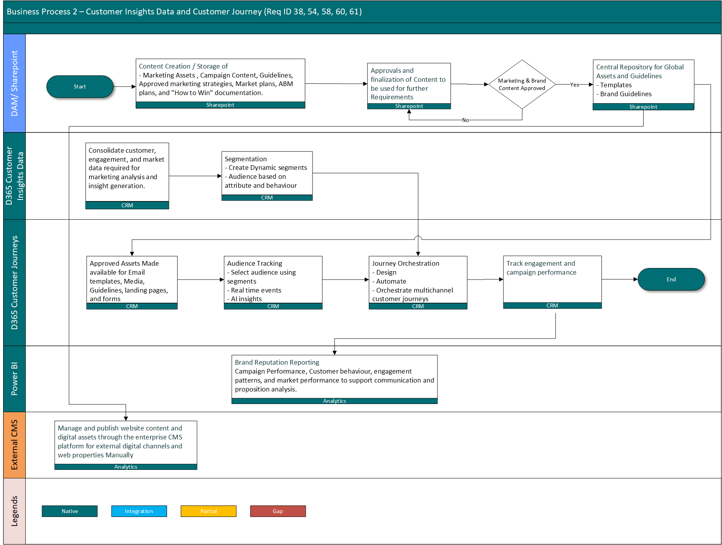
Process Flow 2 – Marketing Research Insights Planning
Standard D365 Customer Insights out-of-the-box, no customisation assumed

Slide 10
Process details: Marketing Research Insights Planning
Market Research Sources
Definition: Research insights are collected from internal and external sources to support marketing strategy and planning.
Insights may originate from market studies, surveys, analyst reports, and industry research.
Research sources should be identified and accessible to planning teams.
Customer and market intelligence should support informed decision-making.
Research inputs should be available for ongoing planning activities.
Insights Consolidation & Analysis
Definition: Research findings are consolidated to identify trends, opportunities, and planning priorities.
Research data should be organized into a consistent view.
Customer, market, and competitive insights should be analyzed together.
Trends and opportunities should be identified from available research.
Insights should support evidence-based planning decisions.
Planning & Decision Support
Definition: Consolidated research insights are used to guide marketing strategies, campaigns, and investment decisions.
Planning activities should leverage approved research findings.
Marketing priorities should be aligned with market opportunities.
Stakeholders should have visibility into supporting insights.
Reporting should enable informed planning and performance tracking.

Slide 11
Global Marketing Content Activation
03

Slide 12
Pre-read: Global Marketing Content Activation
Read before the workshop
Microsoft Learn – Dynamics 365 Customer Insights Journeys
https://learn.microsoft.com/en-us/training/modules/get-started-customer-data-platform/
Please review:
Content management for marketing campaigns
Customer journeys and campaign activation
Email and communication assets
Marketing performance and engagement analytics
Bring to the workshop
Please have the following ready:
Current marketing content repositories (SharePoint, DAM, etc.)
Sample campaign assets and content types
Content approval and publishing process documentation
Examples of campaign performance reporting
Come ready to decide
Decisions we intend to close in this session:
Content sources and repositories in scope
Activation process for marketing content
Content approval and publishing approach
Reporting and performance measurement requirements

Slide 13
Process Flow 3 – Global Marketing Content Activation
Standard D365 Customer Insights out-of-the-box, no customisation assumed

Slide 14
Process details: Global Marketing Content Activation
Marketing Content Repository
Definition: Marketing content is maintained in approved repositories and made available for campaign and communication activities.
Content may include emails, documents, images, videos, and campaign assets.
Approved content should be accessible to marketing teams.
Content repositories should support centralized content management.
Content assets should be available for activation activities.
Content Review & Activation
Definition: Marketing content is reviewed, approved, and activated for use in campaigns and customer communications.
Content should follow the defined review and approval process.
Approved assets should be available for campaign execution.
Marketing teams should be able to select approved content for activation.
Content activation should support planned marketing initiatives.
Campaign Execution & Performance Tracking
Definition: Activated content is utilized within marketing campaigns and measured for effectiveness.
Content should be linked to campaign execution activities.
Engagement and performance metrics should be captured.
Reporting should provide visibility into content effectiveness.
Insights should support future content and campaign planning.

Slide 15
Brand Reputation Campaign Management
04

Slide 16
Pre-read: Brand Reputation Campaign Management
Read before the workshop
Microsoft Learn – Dynamics 365 Customer Insights Journeys
https://learn.microsoft.com/en-us/training/modules/build-journeys-marketing/
Please review:
Customer journeys and campaign execution
Audience segmentation and targeting
Marketing content management
Campaign performance and engagement analytics
Bring to the workshop
Please have the following ready:
Current brand campaign plans and examples
Brand content repositories (SharePoint/DAM)
Existing content approval process
Sample campaign performance reports and KPIs
Come ready to decide
Decisions we intend to close in this session:
Approved content sources for campaign execution
Campaign approval and governance approach
Target audiences and segmentation requirements
Brand campaign success measures and KPIs

Slide 17
Process Flow 4 – Brand Reputation Campaign Management
Standard D365 Customer Insights out-of-the-box, no customisation assumed

Slide 18
Process details: Brand Reputation Campaign Management
Brand Content Management
Definition: Brand content is created, maintained, and approved for use in marketing campaigns and communications.
Campaign content may be stored in SharePoint or an external DAM repository.
Marketing teams should use approved brand assets for campaign activities.
Content should be available for journeys, events, and audience communications.
Brand consistency should be maintained across campaigns.
Campaign Review & Activation
Definition: Brand campaigns are reviewed, approved, and activated before being delivered to target audiences.
Campaign content should follow a defined approval process.
Approved content should be available for campaign execution.
Audience segmentation should support targeted communications.
Campaigns should be activated through Customer Insights Journeys.
Campaign Performance Monitoring
Definition: Brand campaign performance is measured to evaluate engagement and effectiveness.
Campaign engagement metrics should be tracked and reported.
Performance dashboards should provide visibility into campaign outcomes.
Marketing teams should be able to measure campaign effectiveness.
Insights should support future campaign improvements.

Slide 19
Marketing Asset Governance & Campaign Readiness
05

Slide 20
Pre-read: Marketing Asset Governance & Campaign Readiness
Read before the workshop
Microsoft Learn – Dynamics 365 Customer Insights Journeys
https://learn.microsoft.com/en-us/training/modules/build-journeys-marketing/
Please review:
Marketing asset management and content usage
Customer journey and campaign activation
Approval and publishing processes
Campaign performance and engagement analytics
Bring to the workshop
Please have the following ready:
Current marketing asset repositories (SharePoint, DAM, etc.)
Campaign readiness checklists and approval documents
Sample marketing assets (emails, banners, templates, content)
Campaign activation and performance reports
Come ready to decide
Decisions we intend to close in this session:
Approved asset sources for campaign execution
Campaign readiness and approval criteria
Content review and publishing approach
Campaign success measures and reporting needs

Slide 21
Process Flow 5 – Marketing Asset Governance & Campaign Readiness
Standard D365 Customer Insights out-of-the-box, no customisation assumed

Slide 22
Process details: Marketing Asset Governance & Campaign Readiness
Marketing Asset Management
Definition: Marketing assets are created, maintained, and stored in approved repositories for use in campaigns and communications.
Assets may include emails, documents, images, videos, and campaign materials.
Marketing teams should use approved assets from designated repositories.
Assets should be centrally accessible for campaign execution.
Asset consistency should be maintained across campaigns and regions.
Asset Review & Readiness
Definition: Marketing assets are reviewed and approved to ensure they are ready for campaign activation.
Assets should follow an established review and approval process.
Readiness criteria should be satisfied before campaign use.
Approved assets should be available for campaign planning and execution.
Outstanding approval or content issues should be identified prior to activation.
Campaign Activation & Monitoring
Definition: Approved marketing assets are activated within campaigns and monitored for effectiveness.
Campaigns should utilize approved and ready-to-use assets.
Asset usage should support planned marketing activities.
Engagement and campaign performance metrics should be tracked.
Reporting should provide visibility into campaign readiness and outcomes.

Slide 23
Marketing Strategy & Activation Planning
06

Slide 24
Pre-read: Marketing Strategy & Activation Planning
Read before the workshop
Microsoft Learn – Dynamics 365 Customer Insights Journeys
https://learn.microsoft.com/en-us/training/modules/build-journeys-marketing/
Please review:
Marketing planning and campaign orchestration
Audience segmentation and targeting
Customer journeys and campaign activation
Marketing performance measurement
Bring to the workshop
Please have the following ready:
Current marketing strategy and annual/quarterly plans
Campaign planning templates and activation processes
Target audience and segmentation definitions
Marketing KPIs and performance reports
Come ready to decide
Decisions we intend to close in this session:
Marketing planning process in scope
Campaign activation approach and ownership
Audience segmentation requirements
Success metrics and reporting expectations

Slide 25
Process Flow 6 – Marketing Strategy & Activation Planning
Standard D365 Customer Insights out-of-the-box, no customisation assumed

Slide 26
Process details: Marketing Strategy & Activation Planning
Marketing Strategy Planning
Definition: Marketing objectives, priorities, and initiatives are defined to support business goals and target audiences.
Marketing goals and campaign priorities should be documented.
Strategic initiatives should align with business objectives.
Target markets and customer segments should be identified.
Planning activities should provide direction for campaign execution.
Campaign Planning & Activation
Definition: Marketing strategies are translated into executable campaigns, journeys, and communications.
Campaign plans should support defined marketing objectives.
Target audiences should be identified through segmentation.
Customer journeys should be prepared for campaign execution.
Marketing activities should be activated according to the approved plan.
Performance Monitoring & Optimization
Definition: Campaign performance is measured to evaluate outcomes and improve future marketing activities.
Marketing KPIs should be defined and tracked.
Campaign engagement and response metrics should be monitored.
Performance reporting should provide visibility into outcomes.
Insights should support ongoing optimization of marketing activities.

